Slide 1
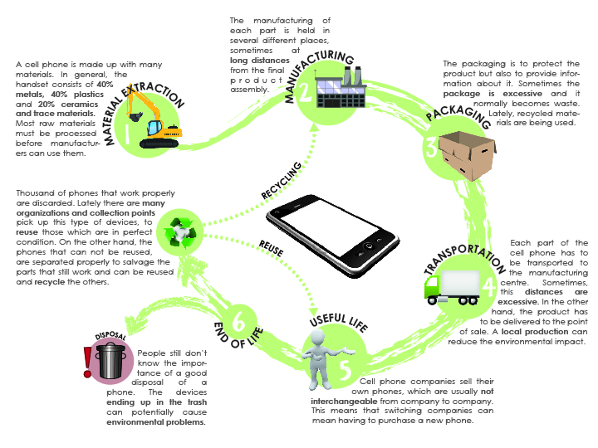
Poverty, Development and the World Economy
Dr Jonathan Leader Maynard
jonathan.leader_maynard@kcl.ac.uk
www.jleadermaynard.com @jleadermaynard

Slide 2
The International Economic System
Key claim of Kenneth Waltz: Must explain world politics with reference to the nature of the international system, not just the nature of states.
Waltz focuses on the international power system, but we can include international economic system.
Consider three examples :
Spanish foundation of Manilla, 1571, and rise of intercontinental trade.
19th Century imperial trade system
Late 20th Century institutionalised globalization
Economic systems constituted by: technologies, institutions, worldviews, distributions of resources.

Slide 3
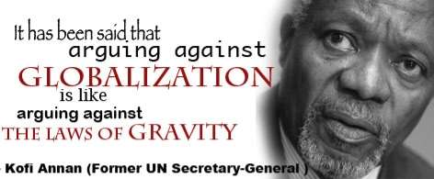

Slide 4
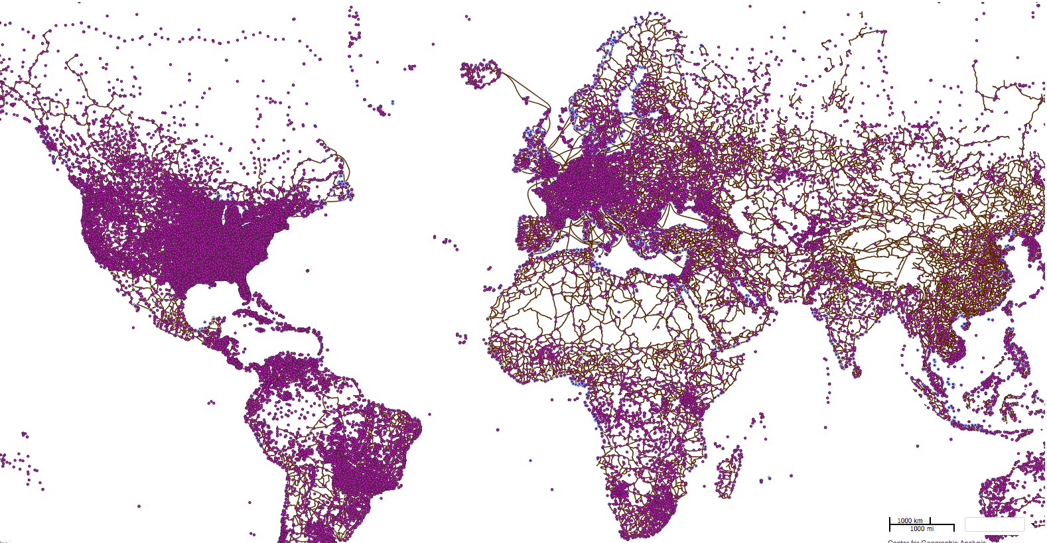
What is Globalisation?
Anthony McGrew (in Globalization of World Politics, 2010):
“a historical process involving a fundamental shift or transformation in the spatial scale of human social organization that links distant communities and expands the reach of power relations across regions and continents”
Uneven, not uniform.
But a system-wide process – so individual states may well feel highly constrained by the pattern of all other behaviour in the system.
Notes:
Map From: https://www.canadiangeographic.ca/article/stunning-interactive-map-shows-globalization-youve-never-seen

Slide 5
Three Waves of Globalization (Piketty 2014)
Roughly 1870-1914, triggered by a) growth of transport and communications technologies, and b) increasing density of global trade within and between colonial empires. Followed by relative ‘autarky’ or low-trade between World War I and II.
Roughly 1944-1971, facilitated by the Bretton Woods trading system advanced by the US (and UK) after World War II. Dominated by trade between North America, Europe and Japan. ‘Ending’ timed to coincide with Nixon’s end of US dollar-gold convertibility, and 1970s ‘stagflation’ crises.
1980s to the present, new technologies encourage genuinely global production networks, neoliberalism promotes increasing economic deregulation, fall of communism and Chinese economic reforms opens up almost the entire world to global markets. ‘Hyperglobalization’ (Rodrik) from 1990s onwards.

Slide 6
(Potential) Impacts of the Third Globalization

Slide 7
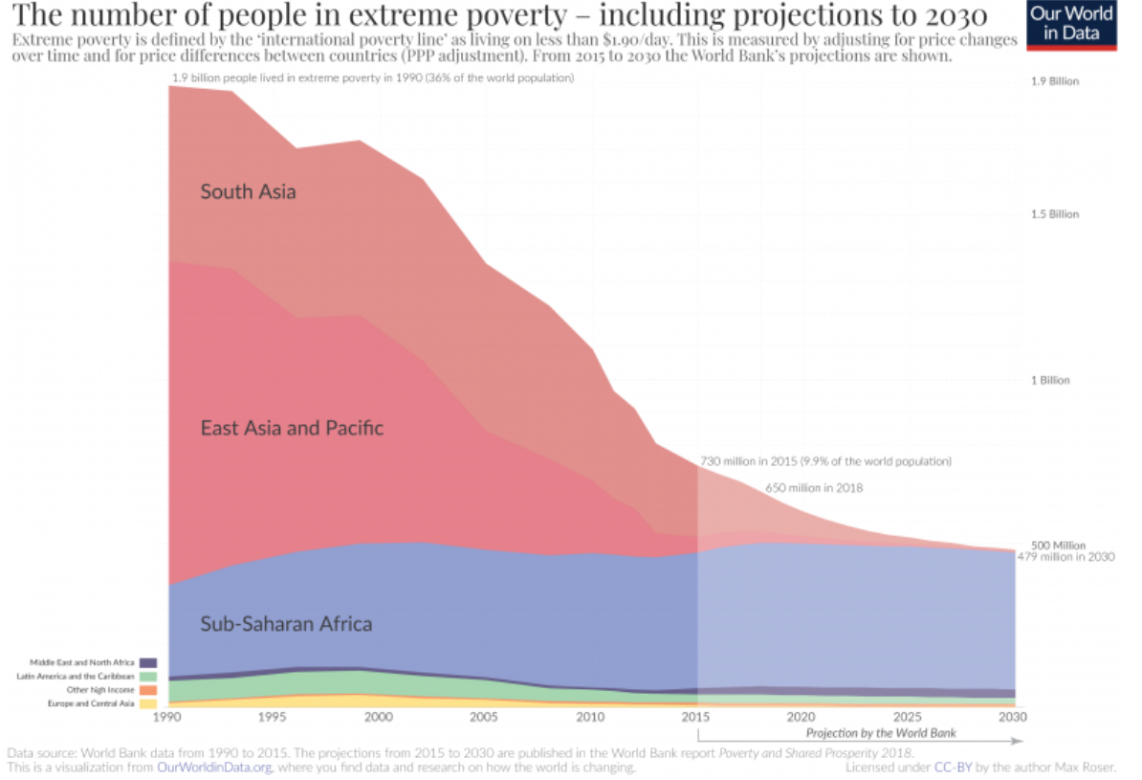

Slide 8
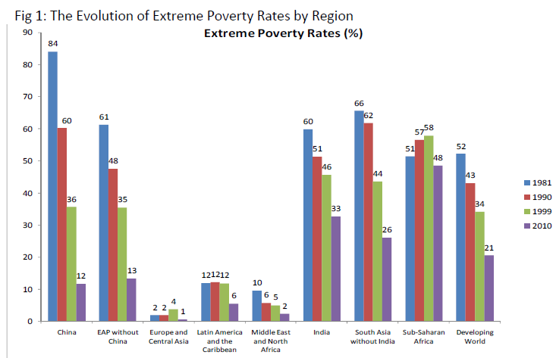
In other words – significant but very uneven progress, and poverty remains dramatically unequal across the globe.

Slide 9
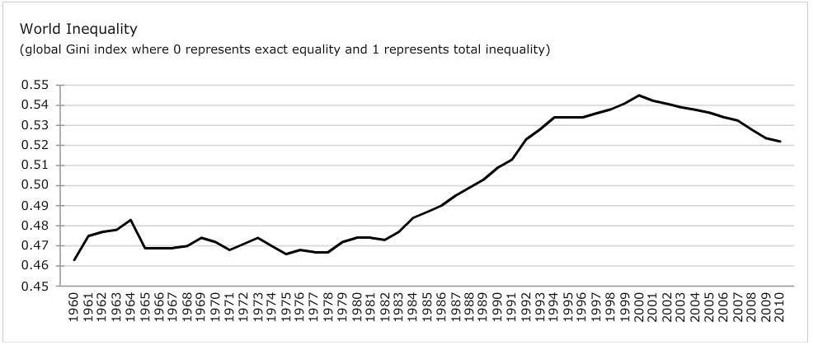

Slide 10
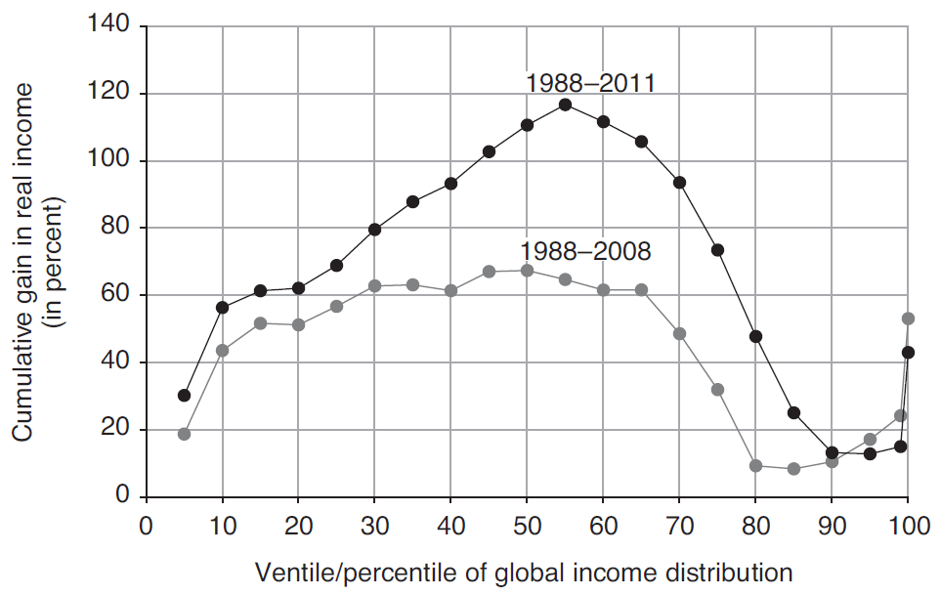
Uneven Gains and Losses
Notes:
Graph from Milanovic, Global Inequality, p.31

Slide 11
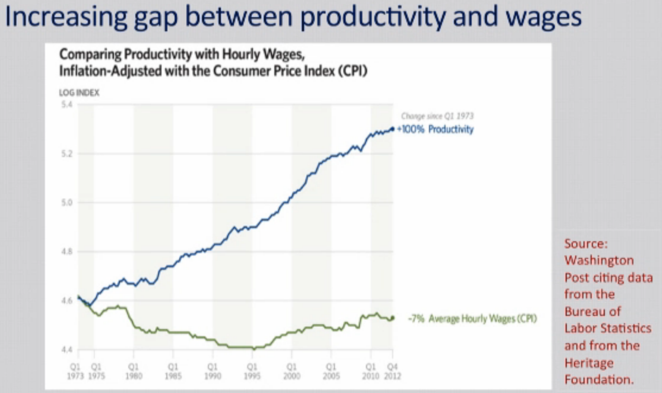

Slide 12
Debating Globalisation’s benefits
Liberalisation of economies has significantly reduced global poverty in certain areas.
Increasing economic interdependence is strongly correlated with the avoidance of war, atrocities and political violence.
Efficient trade and technological integration increase standard of living and reduce costs.
New communications technologies undermine states oppressive capacities and strengthens peaceful protestors and global civil society.
Competition in highly open world economy imposes significant constraints on domestic political choices – Susan Strange’s ‘dictatorship of financial markets’.
Highly diffused economic power and processes may undermine democratic accountability.
New era of globalization may disproportionately benefit the wealthiest 0.0001% of the population.
Open borders and weak regulation facilitate terrorism and transnational crime

Slide 13
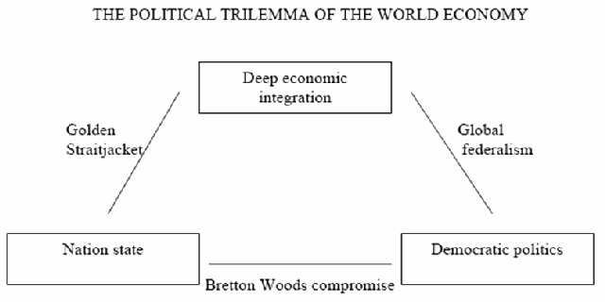
Rodrik’s Trilemma
Notes:
Diagram from: https://rodrik.typepad.com/dani_rodriks_weblog/2007/06/the-inescapable.html

Slide 14
Tackling Poverty and Promoting Development

Slide 15
What are Poverty and Development?
Orthodox View
Critical View
Poverty = lack of money to purchase material needs (income poverty)
Development = ‘modernisation’ of economies through economic growth and integration into world economy.
Strategy: Top-down ‘technocratic’ liberalisation of economies and promotion of foreign investment and large-scale infrastructural or export-orientated projects.
Poverty = multifaceted inability to meet material and non-material needs (income poverty + human poverty)
Development = expansion of human well-being, broadly defined to include social, cultural and political measures.
Strategy: Bottom-up participatory and small-scale projects that protect ‘the commons’ and aim for sustainability and political empowerment.

Slide 16
Global Governance and Development
Three key institutions of the world economy. Originally designed to:
WTO (and previously just the GATT agreements): Created in large part to stop tariff wars and beggar-they-neighbour policies (and also to promote free trade more generally).
World Bank: Raise revenue for investment in reconstruction and development projects (that wouldn’t be funded by the private sector).
International Monetary Fund: Provide loans for countries going through short-term liquidity crises (i.e. unable to meet their budget deficits).
No facility here for helping countries with long-term inability to pay bills i.e. insolvency. So: 1970s Oil Crisis >> Developing World Debt Crisis >> IMF shifts to tackling insolvency via loans + structural adjustment programmes. E.g.:
UK Bailout 1976, for £3.9bn – requires budget cuts.
Ghana Bailout 1983, for £611m, privatises all state industries, cuts all food and fuel subsidies, imposes fees for education and healthcare, cuts to state employees.
United Nations Development Programme, which spends around $5bn a year helping countries tackle poverty and inequality, and now focuses on the Sustainable Development Goals. Much smaller, however, than the World Bank/IMF.

Slide 17
A brief history of development theory
Early Cold War period: dominated by modernization theory, which identified development with westernization, emphasising the need for underdeveloped states to ‘catch up’ by emulating Western states culturally, politically and economically – often under legacy of colonial development plans.
1960s and 1970s: Modernization theory challenged by underdevelopment theories/dependency theory/world systems theory, which emphasised how underdeveloped states were kept underdeveloped by their location in the global economic system.
1970s and 1980s: Key developments challenge both perspetives – rapid growth of certain Asian economies (Singapore, South Korea, Taiwan, Hong Kong and, later, China) while rest of the developing world continues to experience slow growth.
Developing countries also agitate for change in the global economy – through the New International Economic Order movement (founded 1974), and the Group of 77 (founded 1977).
1980s-2000s: Dominated by neoliberal economics, although in the face of increasing challenges.

Slide 18
A brief history of development theory
Human development theory (often associated with Amartya Sen) increasingly influential from 1990s onwards, and influences formulation of the Millennium Development Goals in 2001.
2005: World Bank publishes Economic Growth in 1990s: Leaning from a Decade of Reform, which suggested:
Insufficient attention had been paid to stimulating dynamic forces behind growth.
Objectives of reform could not be translated into ‘one-size-fits-all’ policy prescriptions.
Rules of SAPs and other development restrictions were overly inflexible.
Nevertheless, still significant dissensus about development.
Neoliberalism vs. Its Critics
Those who focus on government failures (e.g. Sachs, or Acemoglu & Robinson, Why Nations Fail) and those that focus external/systemic impediments to development (Chang, Stiglitz).

Slide 19
The Millennium Development Goals

Slide 20
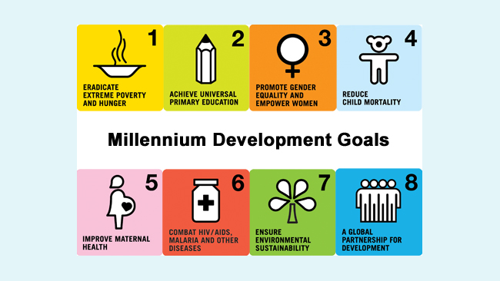
The Millennium Development Goals (MDG) were adapted in 2000: an ambitious UN policy with a range of targets for developing and least-developed countries to decrease vulnerabilities or insecurities to their citizens
The MDGs were target-driven; quantifiable indicators needed to be met within a specific timeframe
Supported by various interventions in various fields with oversight supplied by a UN taskforce.
From 2015, the MDGs have been succeeded by the Sustainable Development Goals.

Slide 21
MDG #1: Extreme Poverty/Hunger
MDG#1 is about the eradication of extreme poverty and hunger:
halve number of people in extreme poverty;
achieve full and productive employment;
halve number of people experiencing hunger
Effects:
By 2012, there were mixed results at the regional level. East Asia and Pacific had reached the goal but others had not. By 2015, all regions at the aggregate except sub-Saharan Africa had achieved the goal.
Mixed results by 2012. By 2015, although the global middle class has grown, the proportion of people in employment has fallen overall (from 62% to 60%)
By 2012, most regions had met targets in terms of undernourished and underweight children. By 2015, there had been an overall 50% drop, but 1 in 9 people in the world (geographically concentrated) remain undernourished
(Kozak et al; MDG Monitor)

Slide 22
Other MDG evaluations
MDG 2 Achieve Universal Primary Education: The goal of achieving universal primary education was just missed, but primary school enrolment rate in developing regions reached 91 per cent this year, up from 83 per cent in 2000.
MDG 3 Promote Gender Equality and Empower Women: About two two-thirds of developing countries achieved gender parity in primary education. Progress has been particularly strong in Southern Asia. Only 74 girls were enrolled in primary school for every 100 boys in 1990. Today, 103 girls are enrolled for every 100 boys.
MDG 4 Reduce Child Mortality: The global under-five mortality rate has declined by more than half since 1990 – dropping from 90 to 43 deaths per 1,000 live births. This falls short of the targeted drop of two-thirds.
MDG 5 Improve Maternal Health: Since 1990, the maternal mortality ratio has been cut nearly in half. This falls short of the two-thirds reduction that was aimed for.
MDG 6 Combat HIV/AIDS, Malaria and Other Diseases: Mixed results. The target of halting and beginning to reverse the spread of HIV/Aids has not been met – although the number of new HIV infections fell by 40% between 2000 and 2013. The global malaria incidence rate has fallen by an estimated 37 per cent and the mortality rate by 58 per cent.
MDG 7 Ensure Environmental Sustainably: Between 1990 and 2015, 2.6 billion people gained access to improved drinking water, meaning the target of halving the proportion of people without access to safe water was achieved. Worldwide, 2.1 billion people have gained access to improved sanitation.
MDG 8 Develop a Global Partnership for Development: Official development assistance from wealthy countries to developing countries increased by 66 per cent in real terms between 2000 and 2014, reaching $135.2 billion.
Notes:
Adapted from: https://www.wvi.org/united-nations-and-global-engagement/article/were-mdgs-success

Slide 23
Major criticisms of the MDGs
Overall progress masks extremely uneven outcomes.
More generally, much progress is unrelated to agreement on the MDGs or efforts to advance them.
MDGs reflect donor-country interpretations and solutions orientated towards a donor-country audience.
MDG framework makes little mention of broader roots of weak development in the global economic system and globalization.
Much development has not been environmentally sustainable.
MDG success has been defined in ways that bias against certain countries – especially in sub-Saharan Africa.

